Slide 1
Time Series
ARMA MODELS : Causal and invertible processes

Slide 2
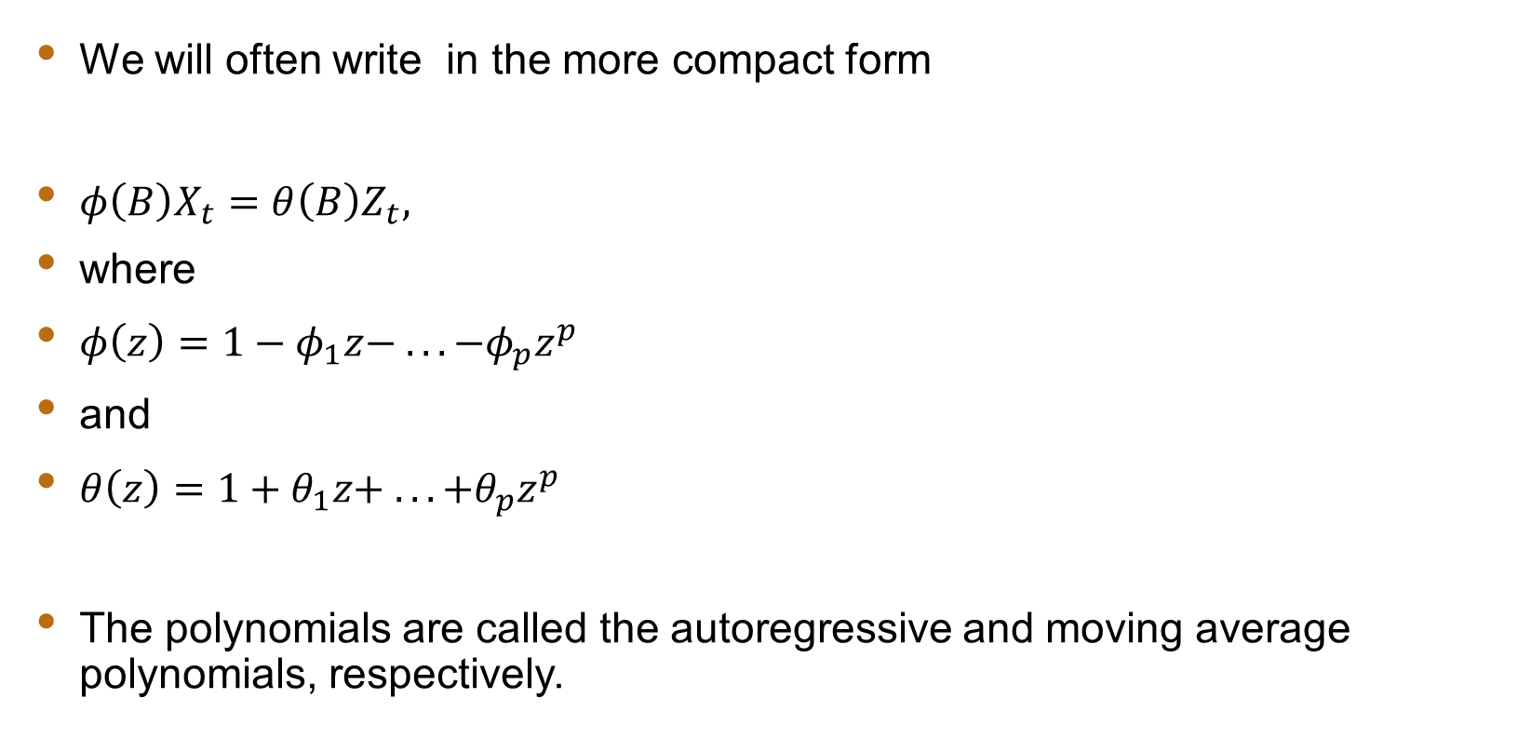
ARMA Model: Notation
We will often write in the more compact form
$φ\left(B\right)X_{t}=θ\left(B\right)Z_{t},$
where
$φ\left(z\right)=1−φ_{1}z− .. . −φ_{p}z^{p}$
and
$θ\left(z\right)=1+θ_{1}z+ .. . +θ_{p}z^{p}$
The polynomials are called the autoregressive and moving average polynomials, respectively.

Slide 3
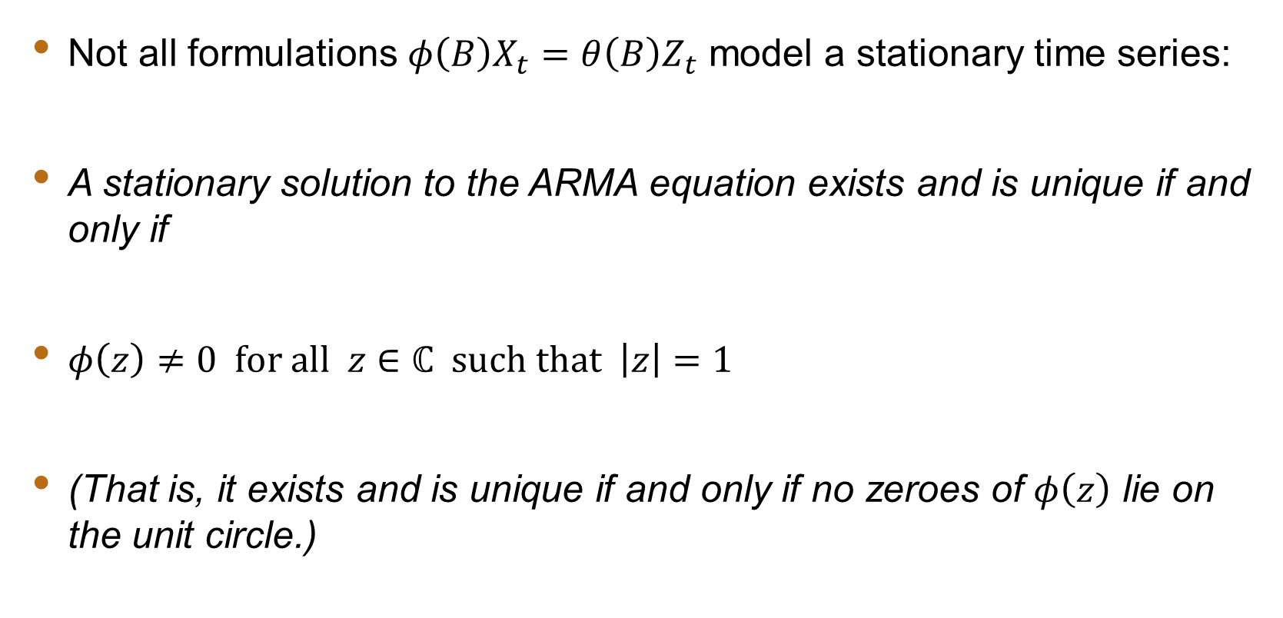
ARMA Model: Stationarity
Not all formulations $φ\left(B\right)X_{t}=θ\left(B\right)Z_{t}$ model a stationary time series:
A stationary solution to the ARMA equation exists and is unique if and only if
$φ\left(z\right)≠0 \text{for} \text{all} z∈ℂ \text{such} \text{that} \left|z\right|=1$
(That is, it exists and is unique if and only if no zeroes of $φ\left(z\right)$ lie on the unit circle.)

Slide 4
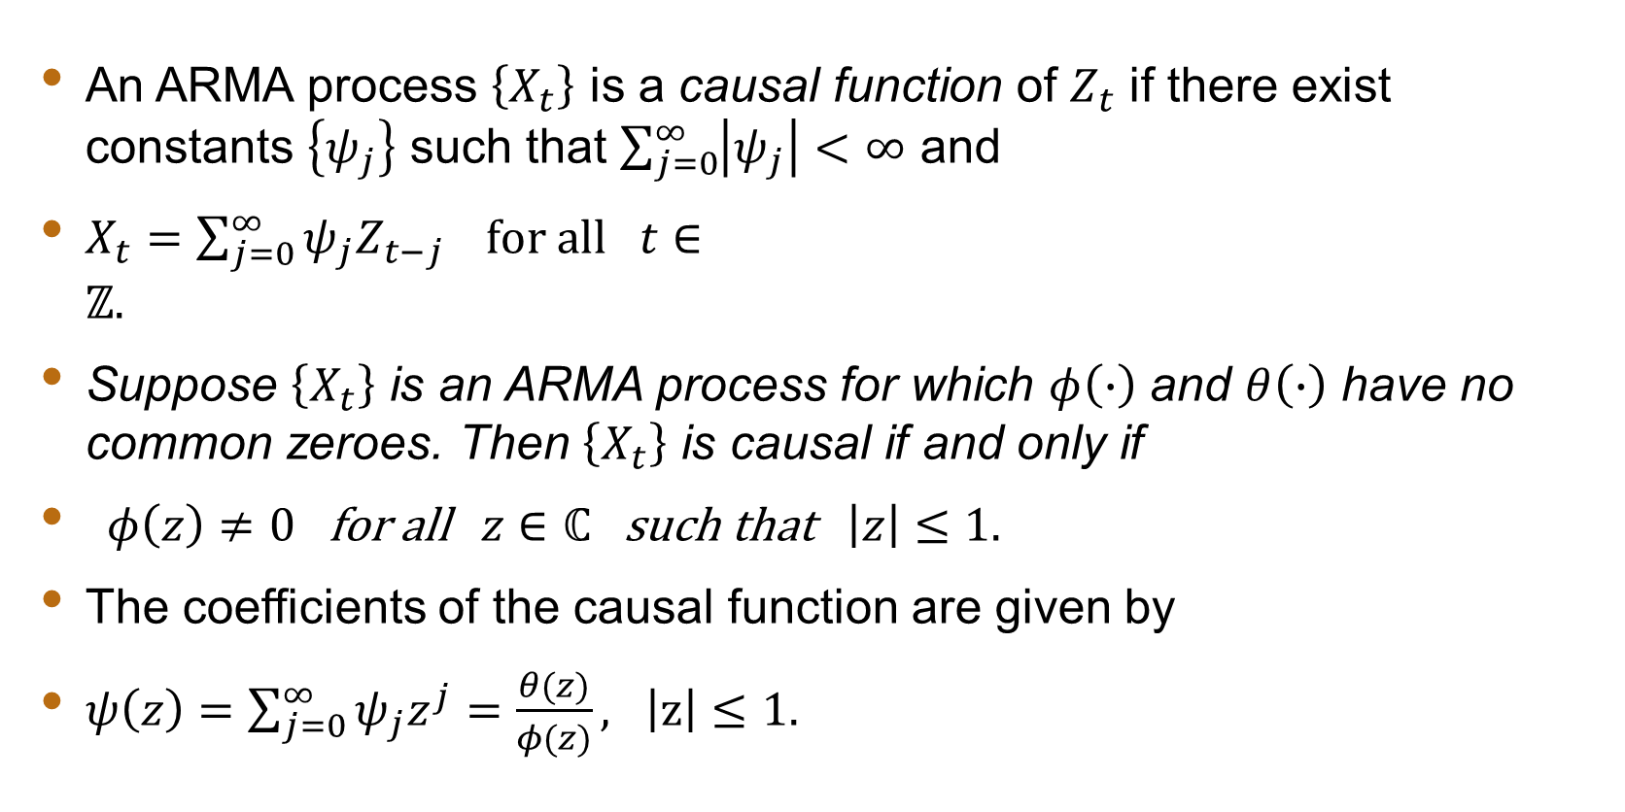
Causal Process
An ARMA process $\left\{X_{t}\right\}$ is a causal function of $Z_{t}$ if there exist constants $\left\{ψ_{j}\right\}$ such that $\sum_{j=0}^{∞}{\left|ψ_{j}\right|<∞}$ and
$X_{t}=\sum_{j=0}^{∞}{ψ_{j}Z_{t−j}} \text{for} \text{all} t∈ℤ.$
Suppose $\left\{X_{t}\right\}$ is an ARMA process for which $φ\left(∙\right)$ and $θ\left(∙\right)$ have no common zeroes. Then $\left\{X_{t}\right\}$ is causal if and only if
$φ\left(z\right)≠0 \text{for} \text{all} z∈ℂ \text{such} \text{that} \left|z\right|≤1.$
The coefficients of the causal function are given by
$ψ\left(z\right)=\sum_{j=0}^{∞}{ψ_{j}z^{j}}=\frac{θ(z)}{φ(z)}, \left|z\right|≤1.$

Slide 5
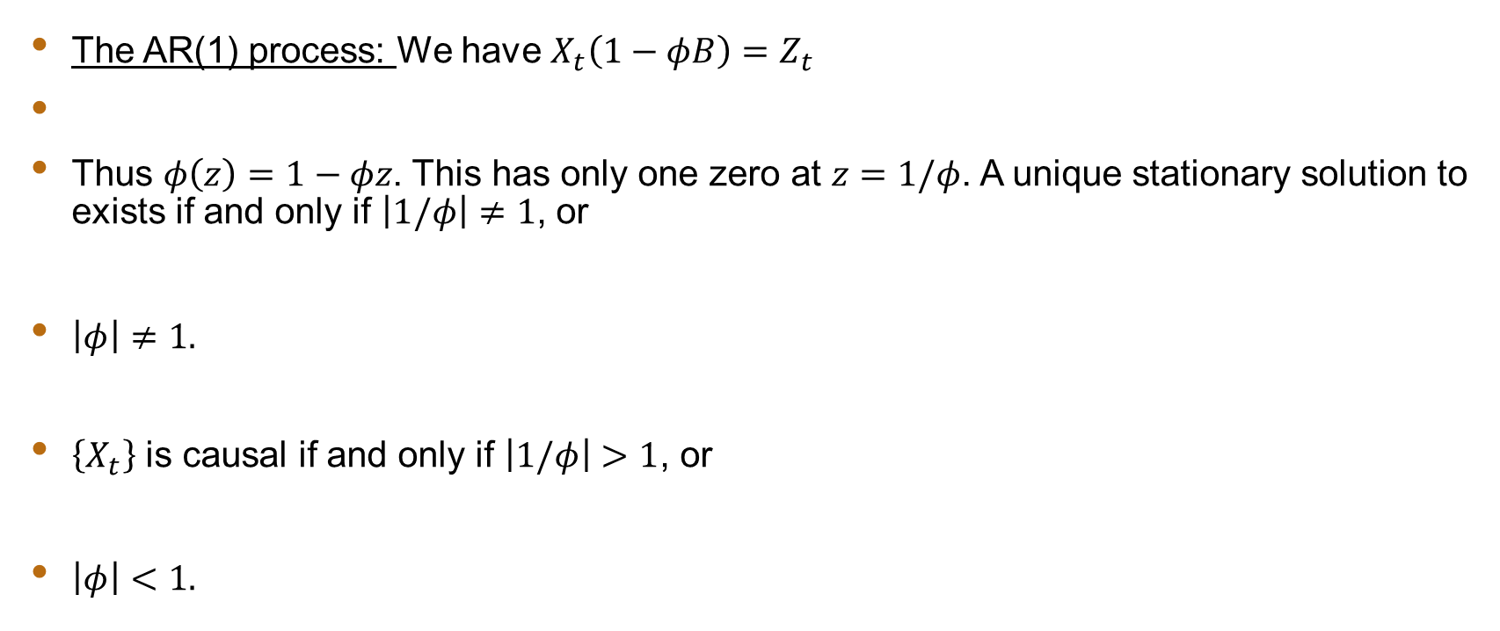
Causal Process: Example
The AR(1) process: We have $X_{t}\left(1−φB\right)=Z_{t}$
Thus $φ\left(z\right)=1−φz$. This has only one zero at $z=1/φ$. A unique stationary solution to exists if and only if $\left|1/φ\right|≠1$, or
$\left|φ\right|≠1.$
$\left\{X_{t}\right\}$ is causal if and only if $\left|1/φ\right|>1$, or
$\left|φ\right|<1.$

Slide 6
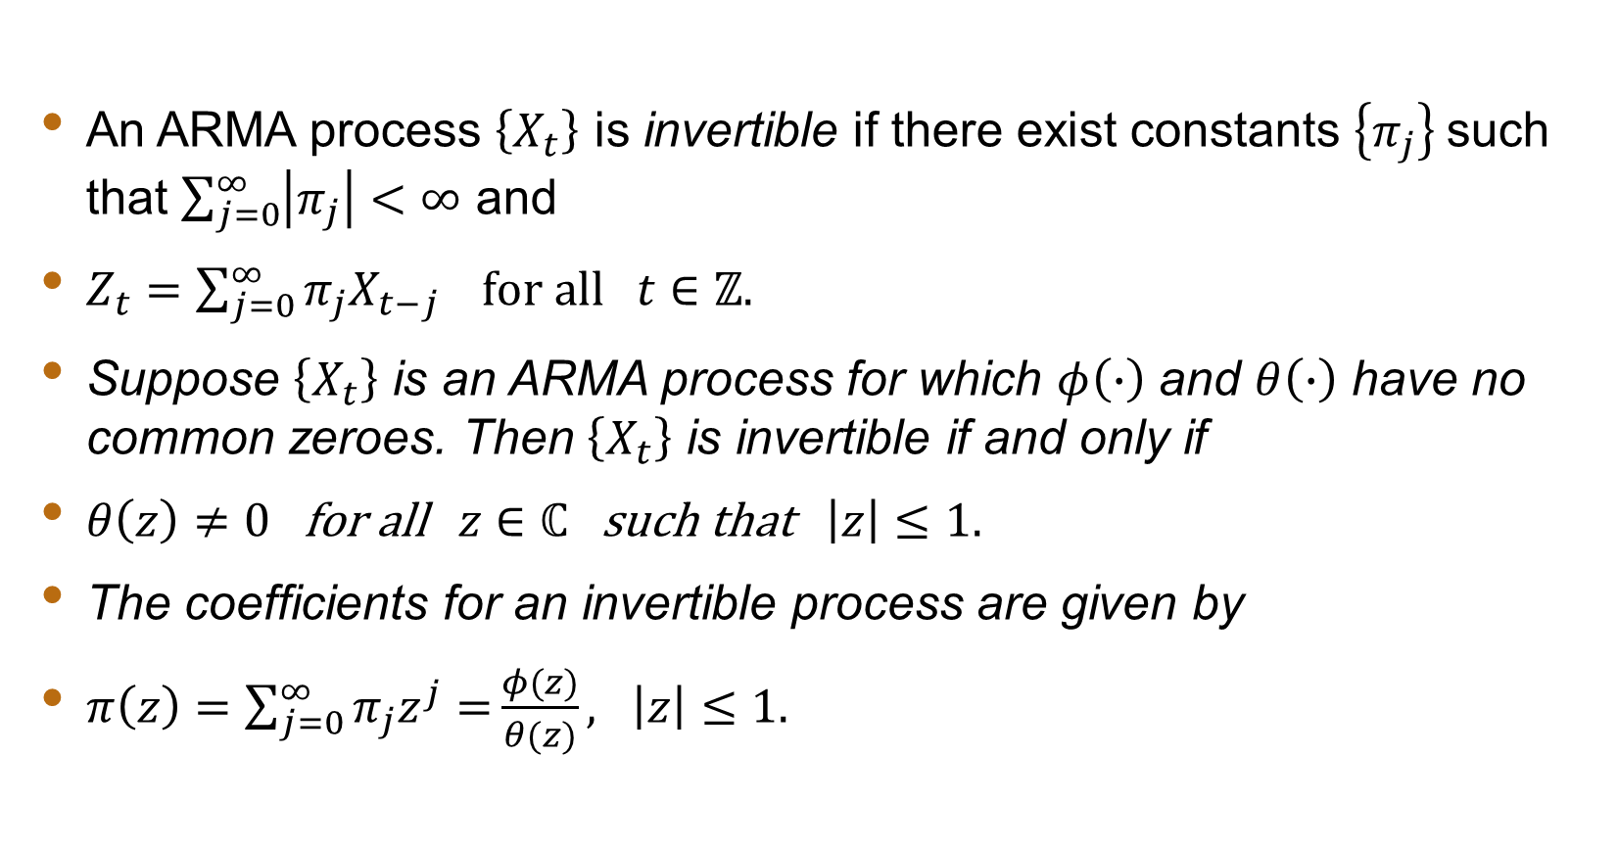
Invertible Process
An ARMA process $\left\{X_{t}\right\}$ is invertible if there exist constants $\left\{π_{j}\right\}$such that $\sum_{j=0}^{∞}{\left|π_{j}\right|<∞}$ and
$Z_{t}=\sum_{j=0}^{∞}{π_{j}X_{t−j}} \text{for} \text{all} t∈ℤ.$
Suppose $\left\{X_{t}\right\}$ is an ARMA process for which $φ\left(∙\right)$ and $θ\left(∙\right)$ have no common zeroes. Then $\left\{X_{t}\right\}$ is invertible if and only if
$θ\left(z\right)≠0 \text{for} \text{all} z∈ℂ \text{such} \text{that} \left|z\right|≤1.$
The coefficients for an invertible process are given by
$π\left(z\right)=\sum_{j=0}^{∞}{π_{j}z^{j}=}\frac{φ(z)}{θ(z)}, \left|z\right|≤1.$

